Slide 1
WCS Online Access Request Instruction
January, 2018

Slide 2
Content:
Requesting Access for Yourself Slides 3-10
Requesting Access for Someone Else Slides 11-22
WCS Online Access Request Instruction | January 2018

Slide 3
Requesting Access for Yourself

Slide 4
Visit: https://wcsonline.comfin.ge.com Click on: Request Access
STEP 1
Tip: To navigate between the first level copy and the first level bullet, use the Indent and Outdent button on the Home Ribbon.
Once you are on the second, and third level bullets, you can Tab and Shift-Tab to go back and forth between the bullet levels.

Slide 5
Click on: “this page” under “For Yourself” section
STEP 2
Tip: To navigate between the first level copy and the first level bullet, use the Indent and Outdent button on the Home Ribbon.
Once you are on the second, and third level bullets, you can Tab and Shift-Tab to go back and forth between the bullet levels.

Slide 6
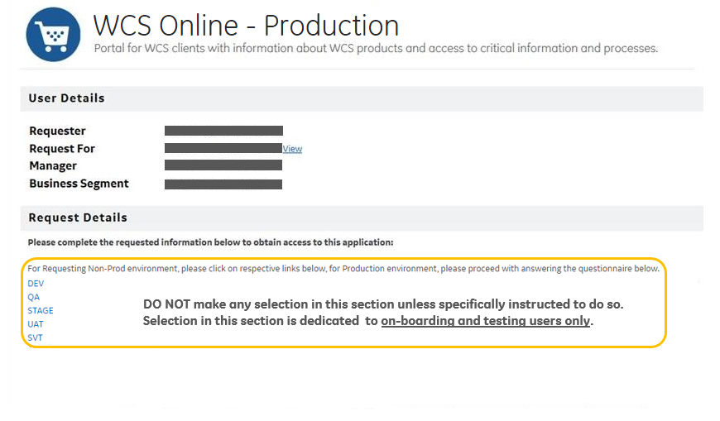
STEP 3

Slide 7
Select your role Please note: if you require access to multiple functionalities you will have to repeat steps 4 and 5 for each functionality.
STEP 4
Tip: To navigate between the first level copy and the first level bullet, use the Indent and Outdent button on the Home Ribbon.
Once you are on the second, and third level bullets, you can Tab and Shift-Tab to go back and forth between the bullet levels.

Slide 8
STEP 5
Once Client Role is selected the Role box will be populated with the name of the required module.
Click on Add to Request button to confirm your selection
Tip: To navigate between the first level copy and the first level bullet, use the Indent and Outdent button on the Home Ribbon.
Once you are on the second, and third level bullets, you can Tab and Shift-Tab to go back and forth between the bullet levels.
Once you click on Add to Request button your selection will appear in Selected Access section.
Repeat Steps 4 and 5 to add access to multiple modules.

Slide 9
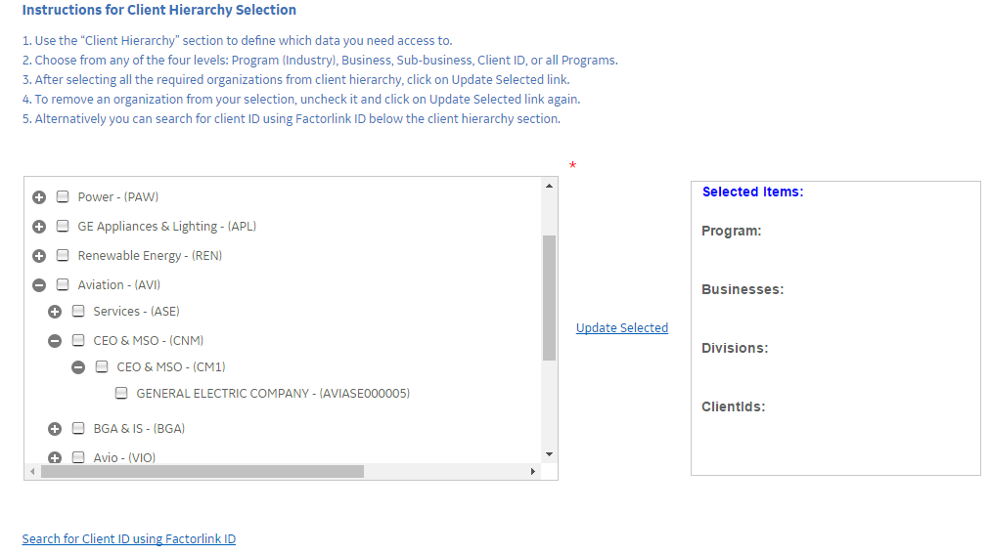
STEP 6
Once you complete Client Hierarchy selection click on Update Selected
Tip: To navigate between the first level copy and the first level bullet, use the Indent and Outdent button on the Home Ribbon.
Once you are on the second, and third level bullets, you can Tab and Shift-Tab to go back and forth between the bullet levels.
Click to drill down to the required level. Place a “Ѵ” at the required level.

Slide 10
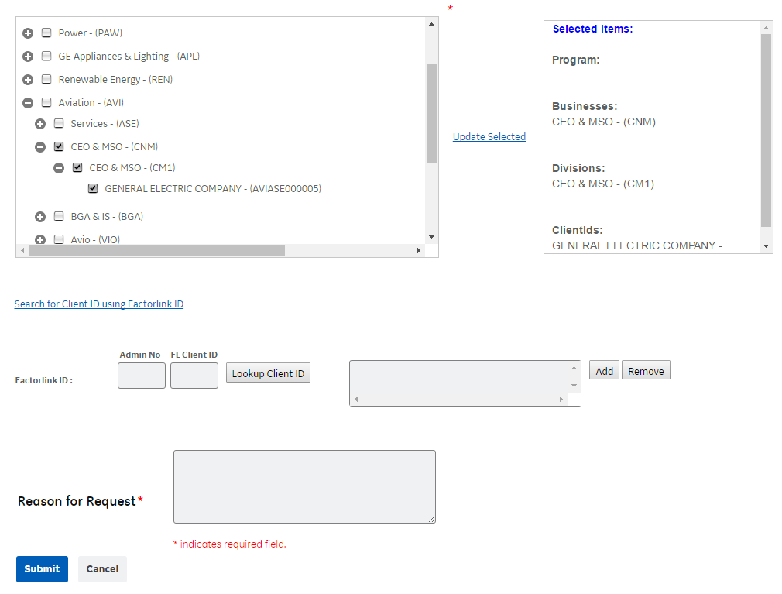
STEP 7
Please Note: to remove/change selection you will have to unselect items in the tree and click on Update Selected to confirm your change.
Once Update Selected is clicked on it will transfer your selection to the Selected Items box
Optionally, instead of using above Client Hierarchy Selection you might chose to look for Client ID by providing Factorlink ID
Specify the reason for your request, why do you require access to WCS Online tools?
Click Submit to complete your request

Slide 11
Requesting Access for Someone Else

Slide 12
Visit: https://wcsonline.comfin.ge.com Click on: Request Access
STEP 1
Tip: To navigate between the first level copy and the first level bullet, use the Indent and Outdent button on the Home Ribbon.
Once you are on the second, and third level bullets, you can Tab and Shift-Tab to go back and forth between the bullet levels.

Slide 13
Click on: “this page” under “For Someone Else” section You will then be re-directed to the Identity Manager page
STEP 2
Tip: To navigate between the first level copy and the first level bullet, use the Indent and Outdent button on the Home Ribbon.
Once you are on the second, and third level bullets, you can Tab and Shift-Tab to go back and forth between the bullet levels.

Slide 14
STEP 3
Tip: To navigate between the first level copy and the first level bullet, use the Indent and Outdent button on the Home Ribbon.
Once you are on the second, and third level bullets, you can Tab and Shift-Tab to go back and forth between the bullet levels.
Type in “WCS Online” in Request Access search field
Click Find Application

Slide 15
Click on: “WCS Online - Capital” under Application search result box
STEP 4
Tip: To navigate between the first level copy and the first level bullet, use the Indent and Outdent button on the Home Ribbon.
Once you are on the second, and third level bullets, you can Tab and Shift-Tab to go back and forth between the bullet levels.

Slide 16
Choose: “Someone else” option and conduct search using either SSO number or First/Last Name
STEP 5
Tip: To navigate between the first level copy and the first level bullet, use the Indent and Outdent button on the Home Ribbon.
Once you are on the second, and third level bullets, you can Tab and Shift-Tab to go back and forth between the bullet levels.

Slide 17
From the search result screen pick up the right person using Request Access option
STEP 6
Tip: To navigate between the first level copy and the first level bullet, use the Indent and Outdent button on the Home Ribbon.
Once you are on the second, and third level bullets, you can Tab and Shift-Tab to go back and forth between the bullet levels.

Slide 18
STEP 7

Slide 19
Select your role Please note: if you require access to multiple functionalities you will have to repeat steps 8 and 9 for each functionality.
STEP 8
Tip: To navigate between the first level copy and the first level bullet, use the Indent and Outdent button on the Home Ribbon.
Once you are on the second, and third level bullets, you can Tab and Shift-Tab to go back and forth between the bullet levels.

Slide 20
STEP 9
Once Client Role is selected the Role box will be populated with the name of the required module.
Click on Add to Request button to confirm your selection
Tip: To navigate between the first level copy and the first level bullet, use the Indent and Outdent button on the Home Ribbon.
Once you are on the second, and third level bullets, you can Tab and Shift-Tab to go back and forth between the bullet levels.
Once you click on Add to Request button your selection will appear in Selected Access section.
Repeat Steps 8 and 9 to add access to multiple modules.

Slide 21
STEP 10
Once you complete Client Hierarchy selection click on Update Selected
Tip: To navigate between the first level copy and the first level bullet, use the Indent and Outdent button on the Home Ribbon.
Once you are on the second, and third level bullets, you can Tab and Shift-Tab to go back and forth between the bullet levels.
Click to drill down to the required level. Place a “Ѵ” at the required level.

Slide 22
STEP 11
Please Note: to remove/change selection you will have to unselect items in the tree and click on Update Selected to confirm your change.
Once Update Selected is clicked on it will transfer your selection to the Selected Items box
Optionally, instead of using above Client Hierarchy Selection you might chose to look for Client ID by providing Factorlink ID
Specify the reason for your request, why do you require access to WCS Online tools?
Click Submit to complete your request

